Slide 1
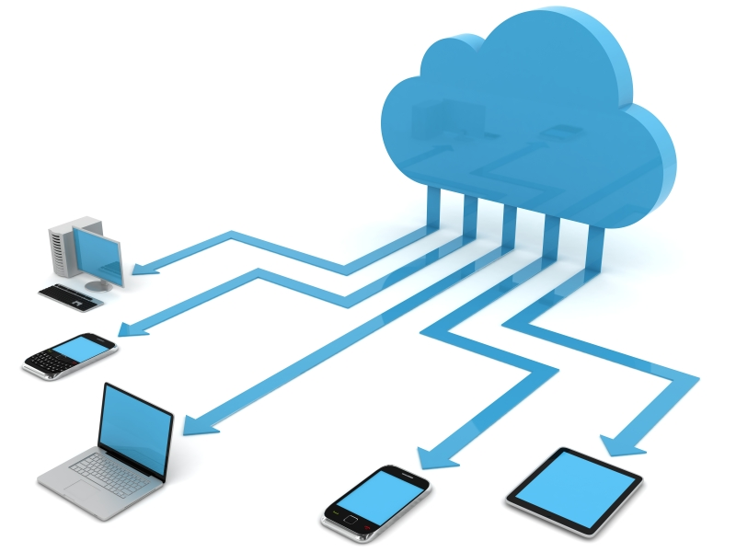
Discussion Unit:
Introduce the tools/vendors available for provisioning larger DSE environments
Provisioning, (Cloud Providers)
Notes:
The goal of this Discussion Unit is introduce the tools/vendors available for provisioning larger DSE environments.

Slide 2
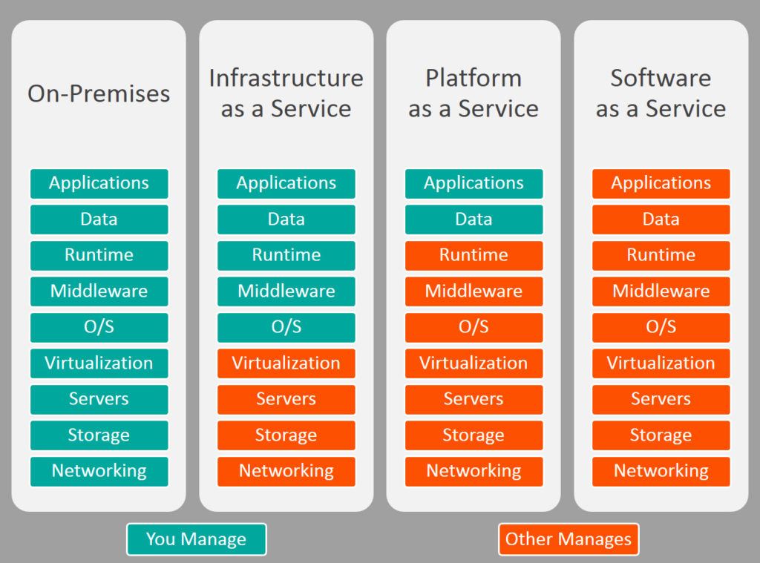
Discussion Lab:
What is ? (Define the term)
Source: http://blogs.bmc.com/wp-content/uploads/2017/09/iaas-paas-saas-comparison-1024x759.jpg
Notes:
On the next page we enter a Discussion Lab.

Slide 3

Cloud, Why: Discuss-
What changes in technology enabled the rise of cloud computing ?
What are the benefits of cloud computing ?
What are (n) essential characteristics of a cloud service ?
Define and state the benefits of:
-- IaaS
-- PaaS
-- SaaS
Source: https://idobi.com/idobi/new-xtremebitz-podcast-24/
0000-DTSE-Cloud-6260-DU-60-3
Notes:
Discuss each of the topics listed-
Reference Urls,
https://slideplayer.com/slide/9419965/

Slide 4
End of Discussion Lab:
Notes:
End of Discussion Lab-

Slide 5




Available to You:
PowerTools / EBDSE
GCE, AWS, Azure
RightScale
-- 3rd party tool
-- Multi-cloud provider
-- Give you (empty) VMs
-- Azure coming
CTool
-- Internal tool
-- Uses RightScale
-- Gives you DSE clusters
PowerTools/EBDSE
-- "Engine Block for DSE"
-- Apps, data
CTool
RightScale
0000-DTSE-Cloud-6260-DU-60-5
0000-DTSE-Cloud-6260-DU-60-5
Notes:
Reference Urls,
https://portal.azure.com
https://cloud.google.com/
https://cloud.oracle.com/home

Slide 6
Just RightScale:
0000-DTSE-Cloud-6260-DU-60-6
0000-DTSE-Cloud-6260-DU-60-6

Slide 7

RightScale Overview:
Management layer for per person usage tracking
Two layers of access, RightScale console and RightScale “Self Service”
Highlevel instance / Cluster / Deployment dashboards
Deploys on GCE or AWS
Various teams have built some templates to utilize
-- The workshop template is an
example of one
0000-DTSE-Cloud-6260-DU-60-7
0000-DTSE-Cloud-6260-DU-60-7

Slide 8
Logging in to RightScale:
Current as of 2018/06/30-
You should have automatically been given a RightScale account and been notified of same via email at time of hire. See image at right-
If not, perhaps try,
nicko.garibay@datastax.com
If not, consult your manager
RightScale login Url, https://login.rightscale.com/login/session/new
0000-DTSE-Cloud-6260-DU-60-8
0000-DTSE-Cloud-6260-DU-60-8

Slide 9
‘Bill-to’ modal dialog:
After username password pair verification, you will receive a modal display asking you to select one of possibly several cost centers to bill your activity to.
The display on the left displays only one such option.
Click the correct account listing to proceed.
0000-DTSE-Cloud-6260-DU-60-9
0000-DTSE-Cloud-6260-DU-60-9

Slide 10

So again ..
There are other installations you can create, via other methods. Using brute force (and brief time and energy), we are proceeding to create a 5 node CentOS version 7 Linux cluster in one hosted AWS availability zone.
6 steps, and they are-
0000-DTSE-Cloud-6260-DU-60-10
0000-DTSE-Cloud-6260-DU-60-10

Slide 11
Step 1: Deployments +New
From the Menu Bar select,
Manage ->
(Deployments) +New
0000-DTSE-Cloud-6260-DU-60-11
0000-DTSE-Cloud-6260-DU-60-11

Slide 12
Step 2: Identify this deployment
Enter a Nickname that includes your DataStax identifying information, optionally a Description, and Click, Save.
Why enter your name ? So that you are more likely to be contacted before someone else blows this deployment away.
0000-DTSE-Cloud-6260-DU-60-12
0000-DTSE-Cloud-6260-DU-60-12

Slide 13
RightScale terminology: Deployment
RightScale is a multi-cloud provider, with which you can deploy nodes (virtual machines, servers) across AWS, GCE, Azure, others. We’re not completing this type of deployment today.
As such, however, RightScale uses terminology different and abstract from any cloud provider.
A RightScale Deployment is an logical construct consisting of:
A number of individual servers, each possibly with a different hardware profile.
A number of arrays of servers. Each server array member will have the same hardware profile. Each single array will reside in one (cloud provider availability zone).
And a mix and/or match of individual and arrays of servers.
Today we are creating one array of five servers.
0000-DTSE-Cloud-6260-DU-60-13
0000-DTSE-Cloud-6260-DU-60-13

Slide 14

Step 3: Create an array of servers deployment
Click, +Array
In the dialog bock that is produced, Select “AWS US – Oregon”
And Click, Continue
Do I have to use AWS US – Oregon ? No. However, there are combinations of location, hardware profile, storage options, and related that you can choose that ultimately will not work.
The path we are detailing here works.
Even in one AWS region we can emulate global network latencies and such using Linux trickery.
0000-DTSE-Cloud-6260-DU-60-14
0000-DTSE-Cloud-6260-DU-60-14

Slide 15
RightScale terminology: Server Template
A RightScale Server Template is another abstraction.
If we refer to a given virtual machine image as an OVF, OVA, or VMDK set of files, each cloud provider has specific and differing sets of (rules, requirements, limitation, whatever) before you can load or make use of same.
RightScale uses Server Templates to try and aid you in this task.
Net/net, you can use RightScale Server Templates, even customize them, or use brute force. We prefer brute force.
After we instantiate a given server, if we find we need a given version of Python or whatever on that machine, we’ll just script that update or related.
0000-DTSE-Cloud-6260-DU-60-15
0000-DTSE-Cloud-6260-DU-60-15

Slide 16
Step 4: Select a server template type
Select the RightScale Server Template titled, Base Server Template for Linux (RSB) (v14.1.1)
Then Click, Server Details
Why use this server template ? Because it has worked for us before, providing us the features we desire on the next and subsequent screens.
0000-DTSE-Cloud-6260-DU-60-16
0000-DTSE-Cloud-6260-DU-60-16

Slide 17
Step 5: Server Details
We call to make a number of changes here:
Edit the (Server) Array Name, to include your personal identifier.
MultiCloud Image, and Instance Type, see next slide-
0000-DTSE-Cloud-6260-DU-60-17
0000-DTSE-Cloud-6260-DU-60-17

Slide 18
Step 5: continued
For MultiCloud Image we choose,
RightImage CentOS 7 x64 v14.2 HVM
Why ? Because we wanted CentOS version 7.
Why HVM ? Largely because HVM (versus EBS) gives us exactly what we need for an ephemeral DSE system.
Be advised that HVM or EBS, some AWS machine types are not compatible with both HVM or EBS.
For (AWS) Instance Type we choose,
m3.2xlarge
Why ? The AWS EC2 machine types are listed here,
https://aws.amazon.com/ec2/instance-types/
m3.2xlarge gives us 8 (count) vCPUs, 30 GB RAM, and 2 (count) 80GB SSDs, and its HVM compatible.
Be aware you may need to script formatting, mounting and naming any drives, yadda, after your virtual machine is created.
0000-DTSE-Cloud-6260-DU-60-18
0000-DTSE-Cloud-6260-DU-60-18

Slide 19
Step 5: continued, continued
We’ve never had success using Automatic instance store mapping, so we’ll skip this feature.
Datacenter / Subsets
If you want a DSE system to honestly test RAC placement, DC placement or similar, you will have to make multiple server arrays, each in a different (cloud provider host location, aka availability zone). We are not doing that type of work today, and will leave this entry Checked as, Any.
SSH Key
We need to generate an SSH Key so that we may later login to any of these boxes remotely and safely.
Click, (SSH Key) New, give the key a name, and Click, Save. This drop down list box will then automatically populate.
0000-DTSE-Cloud-6260-DU-60-19
0000-DTSE-Cloud-6260-DU-60-19

Slide 20
RightScale terminology: Security Group
A RightScale Security Group determines the firewall rules your virtual machine will be created with.
Previously, someone at DataStax created the “automaton (default)” Security Group which meets our needs. (In effect, all of the ports are open.)
0000-DTSE-Cloud-6260-DU-60-20
0000-DTSE-Cloud-6260-DU-60-20

Slide 21
Step 5: final
In the drop down list box for Security Groups, Select, ‘automaton (default)’.
Leave the Checkbox titled, “Associate Ephemeral Public IP Address” checked.
And Click, Array Details.
0000-DTSE-Cloud-6260-DU-60-21
0000-DTSE-Cloud-6260-DU-60-21

Slide 22
Step 6: Number of servers, and more.
Change the drop down list box titled, Status, to Enabled.
If set to Disabled, your virtual machines will not be provisioned.
Set the Min and Max Count(s) to 5, because we want 5 servers.
Set Decision Threshold to 10%.
A rounding error in how this software works; if this number is too high, we have seen where the last server is not provisioned.
Set Resize calm time to 3 minutes.
And Click, Confirm -> Finish -> Launch.
(Launch will be below the toolbar.)
0000-DTSE-Cloud-6260-DU-60-22
0000-DTSE-Cloud-6260-DU-60-22

Slide 23


Result of Step 6, and getting around:
This screen is produced as the result of our previous step, Step 6. You can return to this screen at any time via the Info button.
The ‘Status enabled|disabled’ selection will have to be changed to disabled before we can destroy this server array.
The ‘Primary Security Groups automaton’ link shows us our firewall rules, as displayed in the next slide.
The Instances button takes us to our server array status screen, as displayed in 2 slides.
0000-DTSE-Cloud-6260-DU-60-23
0000-DTSE-Cloud-6260-DU-60-23

Slide 24
Security Group (firewall rules): checking
Viewing our specified firewall rules-
We get to this screen via the Info button, Primary Security Groups link.
icmp will give us ping into these boxes.
Otherwise we are wide open for all inbound and outbound TCP/IP.
0000-DTSE-Cloud-6260-DU-60-24
0000-DTSE-Cloud-6260-DU-60-24

Slide 25
Server array status screen:
We arrive at this screen via the Instances button. 5 servers, we have cut the displayed image to afford higher image resolution.
We see that our boxes are operational. It takes several minutes to move from Launch to Operational.
Minimally here we need to grab the ‘public IP address’ for each of the 5 servers. This address is in the Tags column for each server.
0000-DTSE-Cloud-6260-DU-60-25
0000-DTSE-Cloud-6260-DU-60-25

Slide 26
Status, next steps:
Thus far we have created a single array of 5 servers. As a single array, these 5 boxes are all of one machine type and reside in one (cloud provider availability zone).
Next, we need to login into any or all of these boxes to perform our expected work; install and operate DSE or similar.
We will need a copy of our SSH Key.
We will need the public IP address of each of these boxes.
We are going to login using ssh(C) from our laptop into these boxes.
0000-DTSE-Cloud-6260-DU-60-26
0000-DTSE-Cloud-6260-DU-60-26

Slide 27
Logging into box 1: Getting the SSH Key
In Step 5 earlier we generated an SSH Key.
We can retrieve this value from a, Menu Bar -> Clouds -> (our cloud) -> SSH Keys
Click, SSH Keys, then Click the named key we created.
0000-DTSE-Cloud-6260-DU-60-27
0000-DTSE-Cloud-6260-DU-60-27

Slide 28
Logging into box 1: Copying the key value
Copy all of the text including the BEGIN RSA and END RSA lines.
Open any text editor, paste, and save as a named file of your choosing.
A .key suffix is optional, but standard.
We called our file, zzz.key
0000-DTSE-Cloud-6260-DU-60-28
0000-DTSE-Cloud-6260-DU-60-28

Slide 29

Logging into box 1: Get the public IP address
Recall that our server array public IP addresses are available under, Manage -> Deployments -> (your server array name) -> (your server array name) -> Instances -> Tags -> server:public_ip
Capture this IP address.
0000-DTSE-Cloud-6260-DU-60-29
0000-DTSE-Cloud-6260-DU-60-29

Slide 30
Logging into box 1: ssh
From a command window on your laptop, we will need to run ssh, the secure/encrypted shell. On Mac or Linux, this command should be pre-installed.
The key file you created previously must not be publicly readable. On Mac or Linux we change permissions using a chmod 400 command, as displayed at right.
Then we perform a,
ssh –i zzz.key root@34.208.128.8
Assuming our public IP address is 34.208.128.8
0000-DTSE-Cloud-6260-DU-60-30
0000-DTSE-Cloud-6260-DU-60-30

Slide 31
Go forth and prosper-
Now you’re ready to do whatever you came to do; install DSE, break DSE, yadda.
As largely empty server boxes, most folks create a single script that automates all of the settings they prefer:
Download, configure and boot DSE
Install any client drivers you prefer
Other
0000-DTSE-Cloud-6260-DU-60-31
0000-DTSE-Cloud-6260-DU-60-31

Slide 32
Shutting this all down:
By the nature of the work we perform, it is generally expected that you will un-provision any boxes you created once your work is complete.
Go to the Info TAB and ensure that Status is disabled, else RightScale will be configured to resurrect your boxes when you try to terminate them.
Then go to Instances -> Terminate All. There is a safety prompt, then you’re committed.
Like provisioning, the terminate step may take a few minutes.
0000-DTSE-Cloud-6260-DU-60-32
0000-DTSE-Cloud-6260-DU-60-32

Slide 33

Shutting this all down: Confirming
If you wish to be hyper-safe, we actually go back and delete the now empty (un-provisioned) server array.
0000-DTSE-Cloud-6260-DU-60-33
0000-DTSE-Cloud-6260-DU-60-33

Slide 34
Just CTool:
0000-DTSE-Cloud-6260-DU-60-34
0000-DTSE-Cloud-6260-DU-60-34

Slide 35
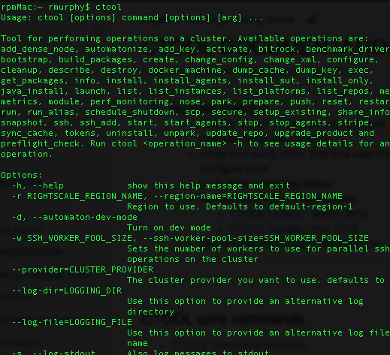
CTool
Datastax built automation
Test Engineering “Toolkit”
Command Line with granular control of environment
Ability to reset environment for repetitive testing
0000-DTSE-Cloud-6260-DU-60-35
0000-DTSE-Cloud-6260-DU-60-35

Slide 36
CTOOL (cont)
Tool to automate the setup of clusters
Originally created and used by the test team
Open to the wider company
Riptano repository
https://github.com/riptano/ctool
what you should be using now
Pull down to install
Make sure to view the readme file
For full documentation see:
https://datastax.jira.com/wiki/display/QA/CTOOL+DOCUMENTATION
https://datastax.jira.com/wiki/display/QA/CTOOL+New+Repo
0000-DTSE-Cloud-6260-DU-60-36
0000-DTSE-Cloud-6260-DU-60-36

Slide 37
CTOOL Requirements
Python 2.7.5 +
On mac use homebrew to install
http://www.howtogeek.com/211541/homebrewforosxeasilyinstallsdesktopappsandterminalutilities/
https://coolestguidesontheplanet.com/installinghomebrewonosxelcapitan1011packagemanagerforunixapps/
DO NOT use mac installed python
Homebrew install will install pip
If get errors when first running ctool may need to install additional modules with pip
Pip install pythonnovaclient pythonkeystoneclient funcsigs wrapt netifaces==0.10.3 positional monotonic
0000-DTSE-Cloud-6260-DU-60-37
0000-DTSE-Cloud-6260-DU-60-37

Slide 38
Create .automaton.conf in Your Home Directory
[cluster]provider = rightscale
[rightscale]
# for the private key: login to RightScale, download SSH private key from: https://us4.rightscale.com/global/users/ssh#ssh,
# save it locally, then set the local path here
user_email = <rightscaleemail>
user_pass = <rightscalepassword>
private_key = /Users/example/bin/keys/example_rightscale_private_key_rsa
# supported cloud providers: ec2, gce
cloud_provider = gce
# account_id as seen in your RightScale url: https://us4.rightscale.com/acct/<account_id>/
account_id = 00000
[logging]
# log file location must be a full path ("~" not allowed)
level = INFO
file = /Users/example/tmp/automaton.log
[credentials]
github_private_key_path = /Users/example/bin/keys/ctool_private_key_rsa
artifactory_user = qaautomaton
artifactory_pass = AKCp2WX2wS8qiMzEmaCureoZ3Tx95B2mTDXfBZLZ6yrYqMdWi6thHX4fuVQGwUDCkoJSde84T
[install]
repo_username = <DSA user name (not email)>
repo_password = <DSA password>
0000-DTSE-Cloud-6260-DU-60-38
0000-DTSE-Cloud-6260-DU-60-38

Slide 39
Basic CTOOL Use
ctool launch p ubuntu MyCluster i m3.2xlarge 2
ctool install b "5.0.0rc2" k 1 s 1 \
MyCluster enterprise enablegraph
ctool start MyCluster enterprise
0000-DTSE-Cloud-6260-DU-60-39
0000-DTSE-Cloud-6260-DU-60-39

Slide 40
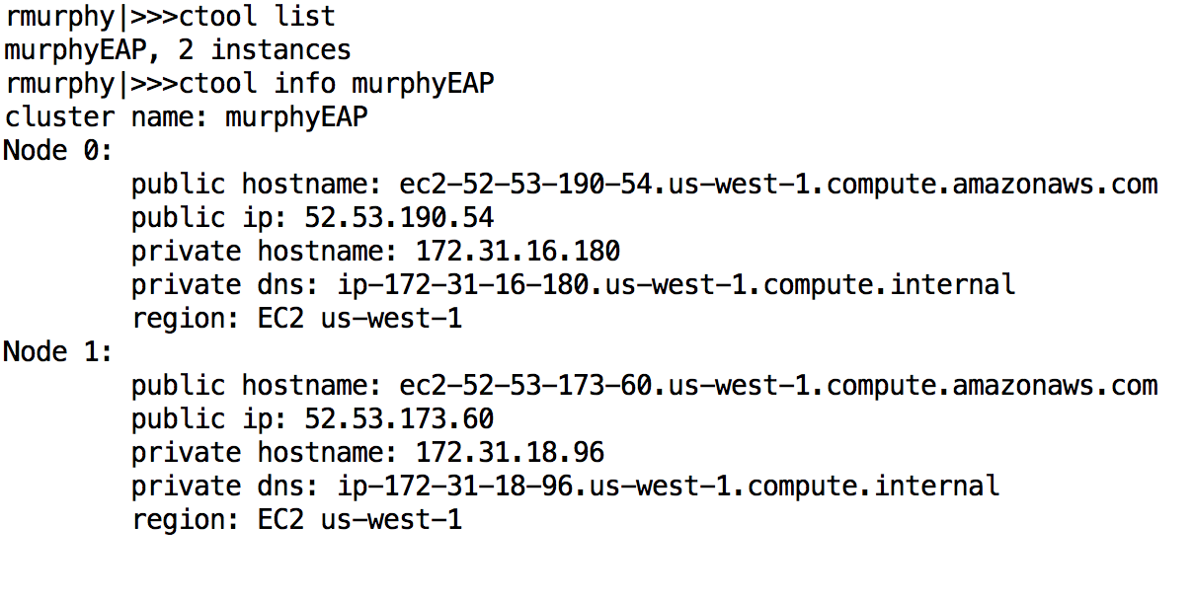
Getting Info
ctool list
ctool info murphyEAP
0000-DTSE-Cloud-6260-DU-60-40
0000-DTSE-Cloud-6260-DU-60-40

Slide 41
Cluster ‘type’
You can specify what parts of DSE to turn on when defining your cluster
e PERCENT_SEARCH
g PERCENT_ANALYTICS
k PERCENT_SPARK
-- PERCENT_* Must be a valid decimal number between 0.0 and 1.0
-- Where 0 is off and 1.0 is 100%
To turn on graph simply use
enablegraph
To enable DSEFS
enabledsefs
0000-DTSE-Cloud-6260-DU-60-41
0000-DTSE-Cloud-6260-DU-60-41

Slide 42
Adding Complexity
Datacenter fun:
ctool launch multiregion 2 "ec2:uswest1:1 ec2:useast1:1”
Security:
-- ctool secure kdc –k
-- https://datastax.jira.com/wiki/display/QA/CTOOL+Secure
Park/Unpark (Currently park works on EC2 using the "rightscale" cluster provider.)
-- ctool park superCluster
-- ctool unpark
-- https://datastax.jira.com/wiki/pages/viewpage.action?pageId=81592724
0000-DTSE-Cloud-6260-DU-60-42
0000-DTSE-Cloud-6260-DU-60-42

Slide 43
Accessing your Servers
You can access your nodes in a couple of ways
Via ctool directly
ctool ssh exampleEAP 0
Or using the ssh key to ssh directly as user automaton
--You will need to put your key into a file with read only permissions for user
ssh i myClusterKey automaton@<external ip>
-- This is the same method used if accessing any cloud based server though
the name may change depending on the template
To retrieve your ID ssh key use
ctool dump_key MyClusterName
0000-DTSE-Cloud-6260-DU-60-43
0000-DTSE-Cloud-6260-DU-60-43

Slide 44
Command Line
You can execute command line actions using ctool to any and all nodes in your cluster
ctool run MyCluster all 'sudo mv /home/automaton /mnt1 && \
sudo ln s /mnt1/automaton /home/’
ctool run MyCluster all 'sudo sed i s/"^authenticator: .*$"/"authenticator: com.datastax.bdp.cassandra.auth.DseAuthenticator"/ /etc/dse/cassandra/cassandra.yaml'
0000-DTSE-Cloud-6260-DU-60-44
0000-DTSE-Cloud-6260-DU-60-44

Slide 45
Building environments quickly
With CTOOL you can
SCP
SSH
EXEC
JAVA_INSTALL
RESET (!!!)
START/STOP AGENTS
UPGRADE
ETC
0000-DTSE-Cloud-6260-DU-60-45
0000-DTSE-Cloud-6260-DU-60-45

Slide 46
Getting Help-
‘ctool’ by itself will give you a list of commands
Once you know the commands you can then get help on them individually by using
-- ctool <command name> help
-- Or ctool <command name> h
For example:
-- ctool install –help
-- ctool start –h
-- ctool list help
0000-DTSE-Cloud-6260-DU-60-46
0000-DTSE-Cloud-6260-DU-60-46

Slide 47
Final on CTool:
CTOOL is great for doing things in house
Test something a customer is doing
Try something new for yourself
General experimentation
And RightScale is the cloud provider manager behind the scenes
Used by CTOOL
Used by Asset Hub
Can build clusters based on templates
But what if you want to demo for a client how to easy it is to build a cluster on the cloud
You don't want to use our internal tools
Because you want to demonstrate in a way they may do it themselves
0000-DTSE-Cloud-6260-DU-60-47
0000-DTSE-Cloud-6260-DU-60-47

Slide 48
Final on CTool:
While AWS is very common some customers prefer using other providers
Maybe do to competition with Amazon
Maybe because they want to have a hybrid cloud strategy
Maybe because of previous relations with one provider over the other
We will not do an install on all providers available but do know
CTOOL and RightScale can provision in AWS or GCE
We have a Strong Partner with Azure
DMC currently uses Azure and AWS
DMC is looking to add either Oracle Cloud or GCE in the near future
No matter which provider you choose the DSE steps are the same and provisioning is based upon the individual console
0000-DTSE-Cloud-6260-DU-60-48
0000-DTSE-Cloud-6260-DU-60-48

Slide 49
Just Power Tools, EBDSE:
0000-DTSE-Cloud-6260-DU-60-49
0000-DTSE-Cloud-6260-DU-60-49

Slide 50
Power Tools
The Vanguard group has been working on a number of tools for internal consumption
We have already spoke some about AssetHub
We next want to introduce EBDSE
-- Engine Block for DSE
-- Internal tool used for testing all aspects of DSE not just the Core as per cassandrastress
Slack channel can be found at
-- #ebdse
Documentation can be found at
-- https://powertools.datastax.com/intro/powertools/
-- Use academy login to access
0000-DTSE-Cloud-6260-DU-60-50
0000-DTSE-Cloud-6260-DU-60-50
Notes:
Reference Urls,
AssetHub Website, https://assethub.datastax.com/

Slide 51
Introduction to EBDSE
Cassandra Stress is very useful to become familiar with
Part of toolset that comes with Open Source Cassandra
Clients may be familiar with or even already using
Thus they may have questions about it
But it doesn’t
Have user friendly data
Work well for testing Search
Hard to make useful data for Analytics tests
Can’t test DSE graph loads
So an internal tool has been developed
EBDSE
0000-DTSE-Cloud-6260-DU-60-51
0000-DTSE-Cloud-6260-DU-60-51

Slide 52
EBDSE
Is an internal only toolset
You can’t leave a copy of it at a customer site
-- Of course you can leave the results of the test, the metrics and such, just not the tool itself
It is a carrot for sales and services to unfold our product
We want to protect ourselves from having an internal tool used against us by competitors
Initially designed to enhance the sales cycle
Be able to do a quick demo
Rapidly showcase a Proof of Technology (POT)
-- SE’s may want to note that fact for their project
-- Many AssetHub assets use EBDSE for testing within
Demonstrate a user experience that will scale
0000-DTSE-Cloud-6260-DU-60-52
0000-DTSE-Cloud-6260-DU-60-52

Slide 53
EBDSE
Core Assumptions around design include
Our customers want to be compelled by facts and evidence, not by ideas alone.
DataStax and our Customers can't afford to spend weeks or months building a custom testing harness for each opportunity just to establish product fit, relevancy, or scale. Establishing value should be as loweffort as we can make it.
Analytic methods for establishing workload sizing are moot without data from real tests. Given the choice, real benchmark data is preferred to estimates.
Do simple things fast!
Simple things should be simple. Complex things should be possible.
0000-DTSE-Cloud-6260-DU-60-53
0000-DTSE-Cloud-6260-DU-60-53

Slide 54
So What is EBDSE
A single scriptable testing system that
Creates human readable data
Can validate a database design
Can provide load metrics
Test systems using CQL
Test systems using DSE graph
Because of the above two also
-- Tests out DSE Search
-- Provides Data to test DSE Analytics
o Does not write jobs for you
Is extensible
-- Internal tool that is tracked in Jira where you can put in bug and feature requests
90% of the time you will not have to do any scripting
-- Just custom yamls that reflect your data model
0000-DTSE-Cloud-6260-DU-60-54
0000-DTSE-Cloud-6260-DU-60-54

Slide 55
How do I get it?
EBDSE is documented at
https://powertools.datastax.com
-- Uses your DataStax academy login
-- Contact Academy team if you can’t get access
-- Also can get help on the command line
o ./ebdse help
o ./ebdse advancedhelp
Has a slack channel for questions and comments
#ebdse
Download at
https://powertools.datastax.com/assets/
curl O https://powertools.datastax.com/assets/ebdse u <dsa account>
0000-DTSE-Cloud-6260-DU-60-55
0000-DTSE-Cloud-6260-DU-60-55

Slide 56
Core Machinery
PowerTools Core
EngineBlock
Provides the core runtime
Docs http://docs.engineblock.io/
VirtData
Provides the generation of data
Docs available at http://docs.virtdata.io/
Github
https://github.com/riptano/ebdse
https://github.com/engineblock/engineblock/
https://github.com/virtualdataset/virtdatajava
0000-DTSE-Cloud-6260-DU-60-56
0000-DTSE-Cloud-6260-DU-60-56

Slide 57
How do I run?
Against default test keyspace (testks) and schema (telemetry)
Download ebdse
Execute
./ebdse v run type=cql yaml=telemetry/telemetryschema.yaml host=localhost
This creates the keyspace and schema
./ebdse v run alias=ops type=cql yaml=telemetry/telemetryops.yaml host=localhost cycles=1000
This runs a test with 1000 cycles, feel free to change the numbers
Read the results
Some results on command line
Detailed Output in scenario*.log
https://powertools.datastax.com/book/intro/quickstart/
Example yaml files
https://github.com/riptano/ebdse/tree/master/ebdse/src/main/resources/activities
0000-DTSE-Cloud-6260-DU-60-57
0000-DTSE-Cloud-6260-DU-60-57

Slide 58
Look at the command help for cql
./ebdse help cql
Note all the options
Note the example yaml file for a custom table setup
0000-DTSE-Cloud-6260-DU-60-58
0000-DTSE-Cloud-6260-DU-60-58

Slide 59
Notes:
End of Discussion Module-

